Slide 1
Test of imhere Mobile app
Ben Ying (Ben), Huiying Liu (Susan), Lei Bao (Richard), Yixiao Gao (Susan3)
Notes:
Good evening everyone~ Today I’d like to share our teamwork, the test of I’m here mobile App.

Slide 2
Index
Introduction
Test Scope
Test Strategy
Test Walkthrough
Defects List
Suggestions
Notes:
Here is the agenda.

Slide 3
Introduction
iMHere is an mHealth platform promoting clinician-guided self-care to patients with chronic diseases.
On the patient side, there are disease state specific smartphone apps
Patients receive new instructions moments after the clinician enters them, and patient responses are immediately available for clinician review. Patients may report problems to their clinician, and the clinician can immediately make adjustments.
The app to remotely deliver and efficiently monitor customized self-care plans to patients, and providing patients with reminders to follow those plans. We are going to pay more attention for the reliability test and how the software protects the user privacy.
Notes:
I’m Here is an mHealth platform developed by a health information lab in Pitt (School of Health and Rehabilitation Science). The whole system is aimed to help physicians and patients to follow the self-care plan for some chronic diseases. The system contains two parts: the patient client, which is an mobile app, and the physician portal, which is a website. We are aimed to test the patient client app as a beta test.

Slide 4
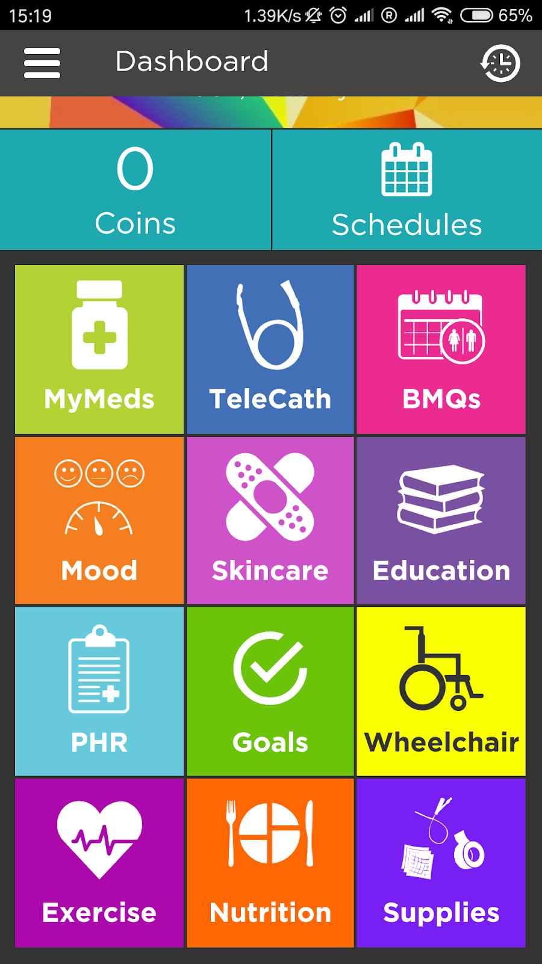
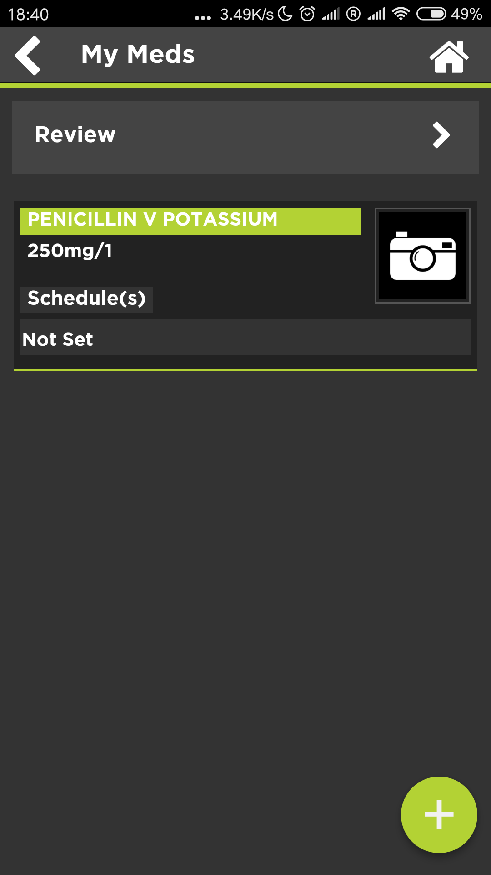
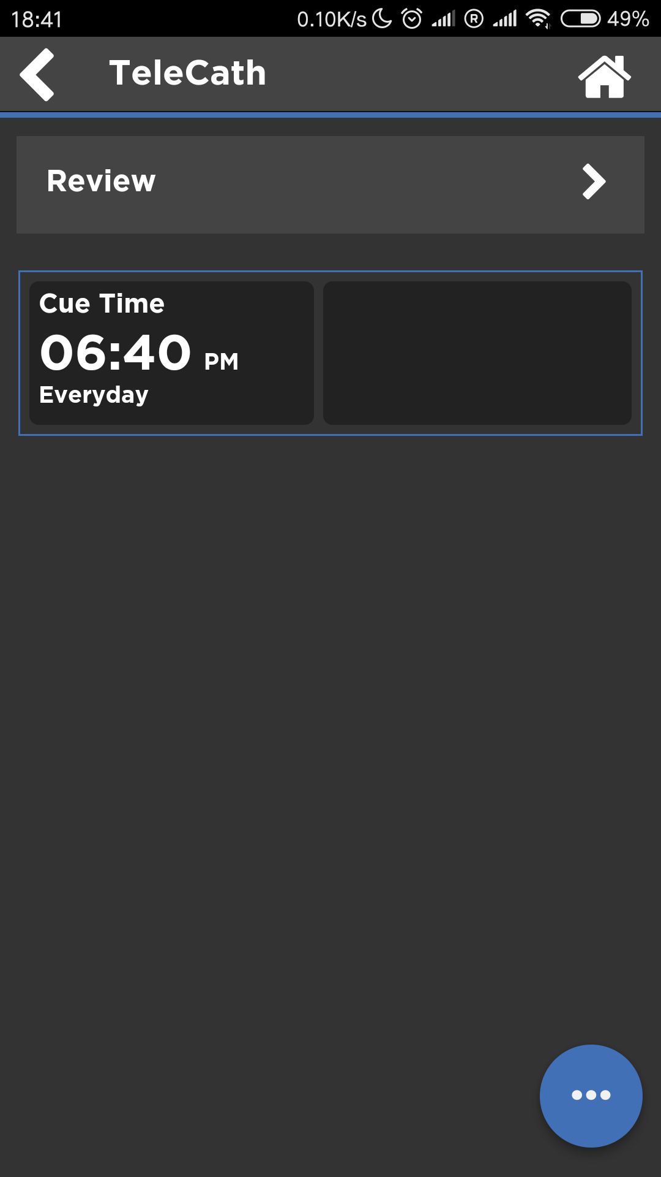

Slide 5
Test Scope
Main Function | Sub menu | Unit Function
Dashboard | Coins | Using Coins to represent progress the user made.
 | Schedules | Includes all the schedule that the user need to follow
 | MyMeds | It includes all the medications the user used.
 | TeleCath | User can add schedule to remind his meeting with remote Doctor.
 | BMQs | User can use this function to set reminder for Bone marrow suppression problems.
 | Mood | User using this function to report mental issue.
 | Skincare | User using this to report wound or set schedule.
 | Education | N/A
 | PHR | User using this function to collect, track and share past and current information about your health.
 | Goals | User using this function to set health goal, challenges, archives.
 | Wheelchair | Manual handbook of Wheelchair.
 | Exercise | User using this function to track exercise status.
 | Nutrition | User using this function to track nutrition intake.
 | Supplies | This function includes the medication supplier’s information.
Messages |  | User using this function to send message to his therapist.
Contacts |  | User can add contact information to make quick contact with others.
Settings |  | The main setting of the application.
Notes:
We have tested all the requirements of each module, which includes both functional requirements and non-functional requirements. Then we did the performance test, which includes compatibility test, such as whether it can be run in different platform, iOS, Android. As a mobile app, the interrupt test is necessary, such as if it can keep state when a phone call comes in while using the app, and so on.

Slide 6
Test Strategy
Function Test
basic dashboard medical function, as well as the installation, uninstallation, running tests, and Test exception handling (ex. the sudden disconnection of the network, insufficient processing of the machine memory, etc.)
Interrupt Test
be able to run normally after receiving calls, receiving SMS, locking screen, alarm rings, etc
be able to run normally when the system switches from background to foreground
Compatibility Test
Hardware adaptation, OS version compatibility, Adaptation of different resolution screens
Property Test
installation and uninstallation time, startup time, page load time, and the CPU, memory, power consumption
Stability Test
memory overflow and null pointer problem
Security Test
User Acceptance Test
Notes:
We listed all of the test strategies that we planed to involved. However, we have no access to accomplish the security test. But as an APP related to patient health records, we strongly suggest to pay attention to user privacy.

Slide 7
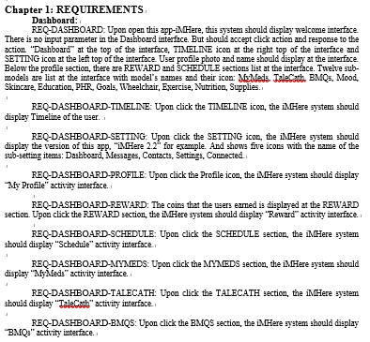
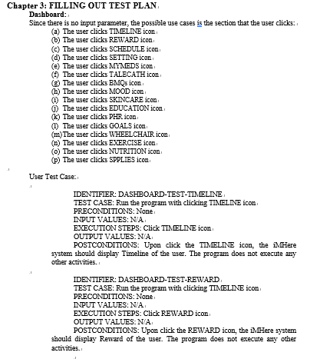
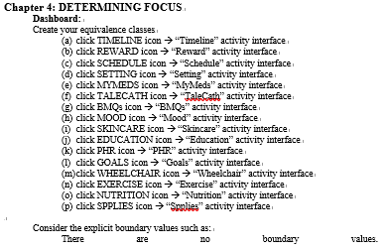
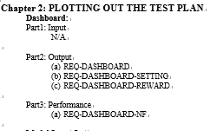
Test Walkthrough
Two parts: functional & unfunctional
Follow the whole step and form the four chapters: requirements, plotting out the test plan, filling out the test plan, and determining focus
Notes:
We followed the whole test walkthrough step by step, from dashboard to each model.

Slide 8
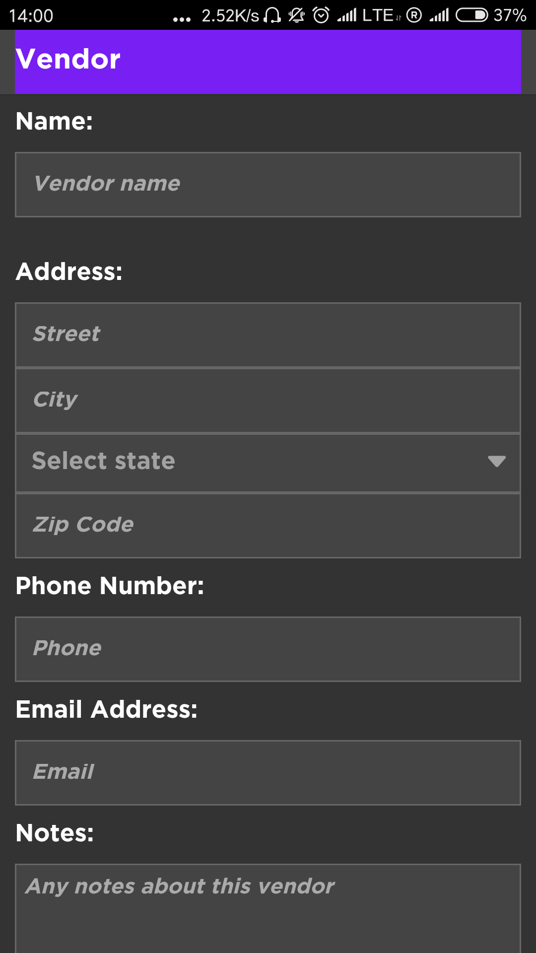
Test Walkthrough
Input:
Valid input
Invalid input
NULL
Blank

Slide 9
Defect and Enhancement
Defect Identifier | Details
VALID-INPUT-LETTER-PARAMETER | With other parameters input correctly, the system displays the next appropriate activity interface. The program does not display “Please enter valid parameter”.
Enhancement Identifier | Details
Property -TEST-Phone-Android | Users can’t click return key to go back to the previous menu
Notes:
After ran all the test cases, we found several defects of the app.

Slide 10
Suggestions
The app should display appropriate message when user input an invalid input.
The system should allow users to use the return key of their smartphones.
Notes:
Based on the defects we found, we give some feedback to the developers.

Slide 11
Thank you!
ANY QUESITONS?

